Slide 1
Lessons learnt from online synchronous teaching in a language MOOC
Hélène Pulker, Bill Alder, Elodie Vialleton, Tita Beaven
Reshaping Languages in Higher Education. July 2014

Slide 2
The MOOC Travailler en français

Slide 3
The Travailler en français MOOC
The first ever French-as-a-foreign-language teaching MOOC (Vaufrey, 2013)
4 Instituts Français and The Open University
15 January to 15 March 2014
Focus on French for employability
Pitched at CEFR level B1

Slide 4
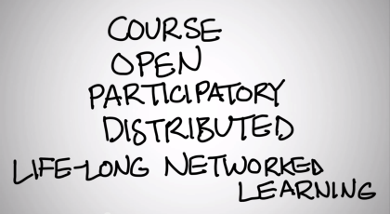
Principles
Cormier (2010)
Cormier (2010): ‘A MOOC is a course […]. It has facilitators, course materials, it has a start and an end date, it has participants […] It is, maybe most importantly, an event, around which people who care about a topic can get together and work and talk about it in a structured way.’
→ tools selected to fit constructivist principles (esp. forums and teleconferencing)
Also a task-based MOOC (Lane, 2012), where ‘community is crucial […] but it is a secondary goal’.
→ a level of instructivism
Voir les 4 principes, voir Mirjam xmooc??

Slide 5
Users (15 Nov to 15 March)
About 1,200 officially registered students by 15 January
102 students requested a completion certificate
12,543 unique website users over 4 months
Average of 156 users / 192 sessions per day
23,265 sessions
50% of new visitors did not go past the first page (bounce rate)
On average: 3 page views per session

Slide 6
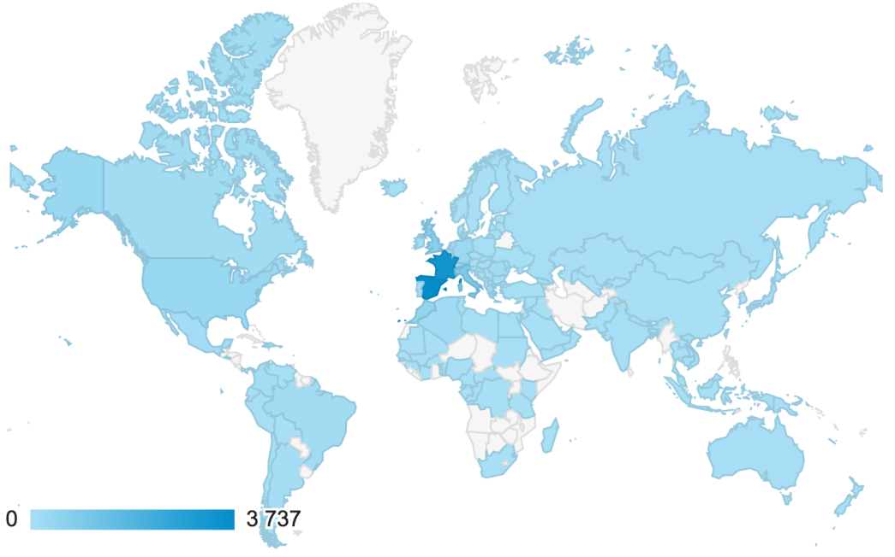
Location of participants

Slide 7
Location of participants: top 10 countries

Slide 8
Tools
Main platform: a google site
Reference documents: google docs / google drive
Questionnaires: google surveys
Synchronous events: Blackboard Collaborate (recordings posted on vimeo)
Asynchronous forum discussions: weebly
Audio podcasts: soundcloud
Social networking (promotion): facebook and twitter
External resources (e.g. videos, links to websites)

Slide 9
MOOC structure
An introduction week
5 thematic weeks :
Looking for a job
Preparing a CV
Writing a cover letter
Preparing for a job interview
Working in a multicultural team
An evaluation week

Slide 10
Content
A weekly ‘feuille de route’: programme of activities, 5 hours/week
Activities for guided independent learning
Activities for reflection
Collaborative activities
2 weekly synchronous sessions (teleconferencing)
Activities for self-evaluation

Slide 11
Detailed content structure: week 1
Activities | Resources
Reading activity | Online article
Online personality test > forum | Online interactive activity
Online synchronous session: thematic | Teleconferencing
Online synchronous session: language | Teleconferencing
Online activity | Online job and training site
Reading activity | Online article
Evaluation | Google questionnaire
Follow up resources | Public website. Audio and video clips. Forum

Slide 12
The synchronous sessions
2 synchronous sessions a week:
1 focusing on language, facilitated by a language teacher
1 focusing on content, lead by a careers or professional expert

Slide 13
Reflecting on the use of synchronous language sessions

Slide 14
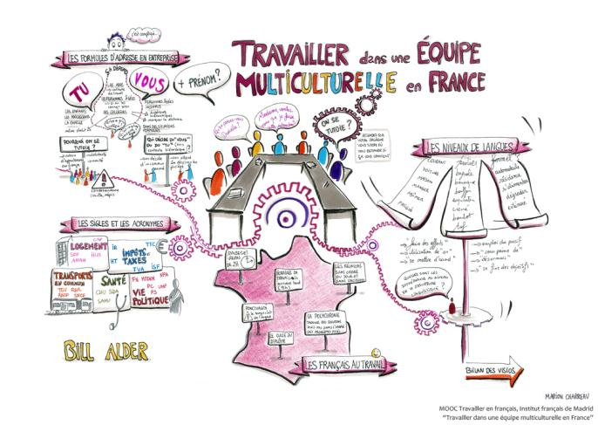
The language synchronous sessions
Parler de son bilan professionel
Rédiger un CV
Rédiger une lettre de motivation
Savoir parler de soi (pendant un entretien)
Travailler dans une équipe multiculturelle en France

Slide 15
Data
Notes and reflections from 2 of the facilitators immediately after each sessions
Observation of all the recorded sessions 3 months later by the same 2 facilitators and by one external observer

Slide 16
Research questions
Was the approach to online language teaching used in traditional online language tutorials successful in the context of the MOOC?
Do synchronous online language sessions have a role to play in a language teaching MOOC?

Slide 17
Blackboard Collaborate tools

Slide 18
Format of language sessions
2 main facilitators, 1 taking the lead
1 extra moderator managing a ‘technical help’ breakout room
4 to 6 other teachers observing, occasionally participating
Series of activities (5 or 6) each using different whiteboard screens and having at least one interactive element (voting, comment in chat, interaction on whiteboard)
In sessions 1 and 2, one small group speaking activity in breakout rooms

Slide 19
Participation and duration
 | Topic | Session duration | Participants
1 | Chercher un emploi | 1:10 | 24
2 | Rédiger un CV | 1:05 | 26
3 | Rédiger une lettre de motivation | 0:48 | 25
4 | L’entretien de recrutement | 1:03 | 18 (technical issues at start)
5 | Travailler dans une équipe multiculturelle | 1:00 | 19

Slide 20
Assumptions before the sessions
Assumptions the learning design was based on:
OULive tutorials designed for support more than content (flipped classroom design).
OULive tutorials designed to provide opportunities for practice in speaking and spoken interaction.
Expectation that students who attend will participate in interactions.
Expectation that students are self-motivated and supportive of each other.
Expectation that participants would have IT and participatory literacy (Jenkins 2006)
Notes:
What we expected to do and observe based on OU experience:
= la base du learning design ie activities for communicative approach, interaction, etc.
OULive tutorials designed for support more than content (flipped classroom design).
OULive tutorials designed to provide opportunities for practice in speaking and spoken interaction.
Expectation that students who attend will participate in interactions.
Expectation that students are self-motivated and supportive of each other.
+ expectation that participants would be IT literate

Slide 21
Observations following the sessions
Observations made during and after sessions:
Sessions used to keep up motivation and, mainly, for content.
The opportunity for speaking practice was not taken up by the majority of participants.
The majority of participants remained silent observers.
Most of the interactions were between facilitators and participants, not between different participants.
Were participants IT literate and adept at online social interaction?

Slide 22
Discussion: successes
The number of participants was fairly stable.
Participants were satisfied with the sessions. They were able to get instant feedback on questions and to practise spoken reception and written interaction skills.
The two facilitators were more positive about the sessions after observing them again than they were immediately afterwards.
The design of sessions was not effective to elicit spoken interactions between students, but it did elicit other interactions.

Slide 23
Discussion: issues
A different type of student engagement and motivation
Different levels of self-regulation compared to OU students?
Intercultural issues / behaviours
Short timeframe: lack of time to establish common rules?
Issues around the balance between students and teachers in participants
→ Difficulty to create a one-size fits all learning design.
Notes:
A different type of student engagement and motivation
(same diversity of participants as in OU tutorials, but lacked the commonality of purpose that is found amongst OU students within a module)
Different levels of self-regulation compared to OU students?
Intercultural issues / behaviours : but commun = parler fçs, ms différences interculturelles (eg comportements au travail)
(The OU has a very strong ethos which is made explicit and which is prominent. More clarity about what is and isn’t acceptable behaviour, and about how to conduct oneself. On the MOOC, ICC skills less evident.)
Issues around the balance between students and teachers in participants
On OU module, all the students are there to pass the module. Their ultimate goals might be different, but they all want to pass. Those who attend tutorials therefore share the same goal of achieving the module learning outcomes. The MOOC participants expected to be more passive?

Slide 24
Conclusions
There is a role to be played by online synchronous sessions to elicit real-time interactions, but they are not likely to be spoken interactions.
They do add value compared to asynchronous interactions (providing instant feedback on activities, and practice of spoken reception skills with opportunity for questions).
MOOCs are a different context from traditional courses; different assumptions must be used in the design of synchronous sessions.

Slide 25
References
Cormier, D. (2010a). “What is a MOOC?” Retrieved from http://www.youtube.com/watch?v=eW3gMGqcZQc
Jenkins, H. (with Clinton, K., Purushotma, R., Robison, A. J., & Weigel, M.). (2006). Confronting the challenges of participatory culture: Media education for the 21st century. Chicago, IL: MacArthur Foundation. Retrieved from http://digitallearning.macfound.org/atf/cf/%7B7E45C7E0-A3E0-4B89-AC9C-E807E1B0AE4E%7D/JENKINS_WHITE_PAPER.PDF
Lane, L. (2012). Three kinds of MOOCs. Retrieved from http://lisahistory.net/wordpress/2012/08/three-kinds-of-moocs/
Vaufrey, C (2013) "Travailler en français", le premier MOOC de FLE. Retrieved from http://cursus.edu/article/21244/travailler-francais-premier-mooc-fle/#.UzMK6Kh_tQA

Slide 26
elodie.vialleton@open.ac.uk Faculty of Education and Language Studies The Open University Walton Hall Milton Keynes MK7 6AA
Thank you!
www.open.ac.uk

